Slide 1
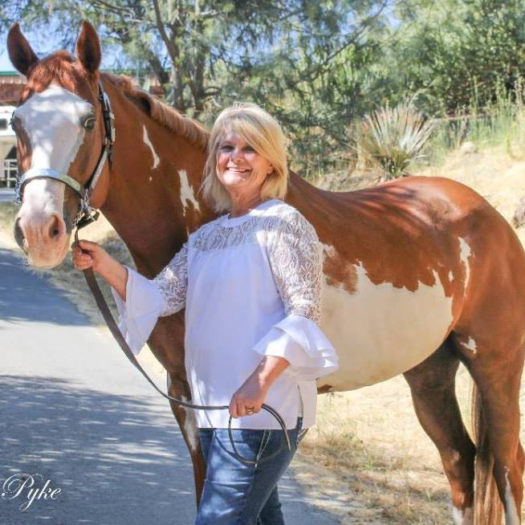
This will be your best semester EVER!
Growth Mindset
Professor Kathleen Sullivan
Indiana University South Bend
School of Education
Director, U100

Slide 2
School of Education Gift to Me

Slide 3
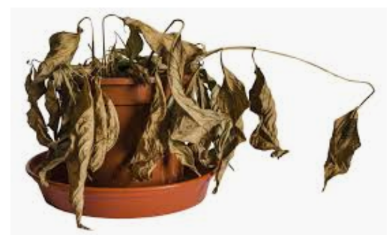
The fate of all my plants

Slide 4
Loser
Never been good at keeping plants alive
You need a “green thumb” and I don’t have one
Why bother, if I know my plants always die
I could ask someone to help me, but I don’t want
anyone to see how pathetic my plant skills are

Slide 5
What about you?
What is your “Plant”?
Doomed to be lousy at Math, English, Science, History, etc.
Why bother to try? Give up easily?
Wont’ ask for help. Focus – don’t want to look bad.
Don’t get feedback so can’t improve.

Slide 7
Growth Mindset with My Plant
Growing a plant is a skill – I can learn how to do this!
In the past I barely watered the plant since I figured it would die anyway.
Now I will put in the effort because I believe I have a chance to grow this plant.
I definitely need coaching. I will google “how to care for your type of plant.”
I will ask friends who are good with plants for tips.
If my plant looks like it’s in decline, I will get help from a friend.

Slide 8
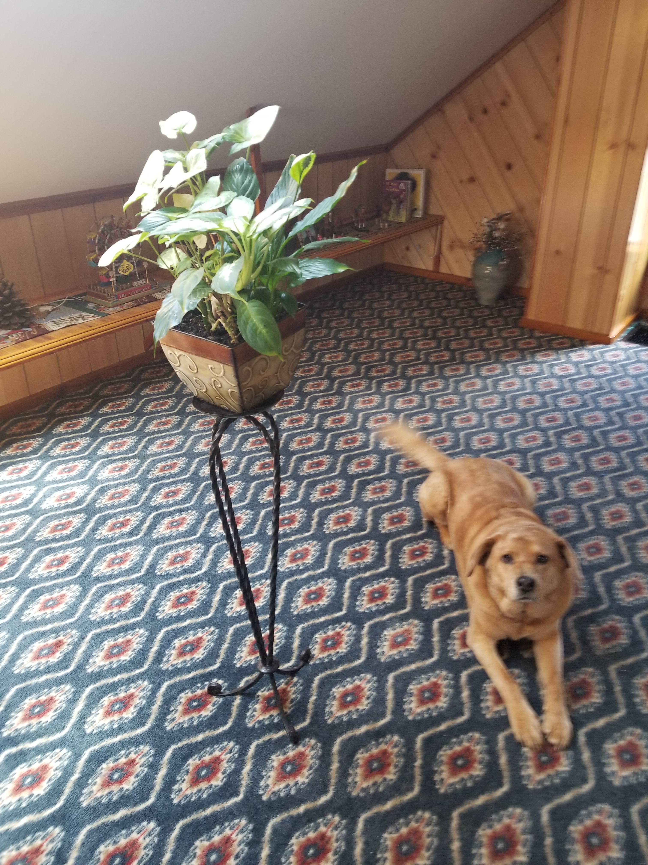
My Plant Matilda is now 2 years old!

Slide 9
YOU and GROWTH MINDSET
Writing Papers
Fixed Mindset
Growth Mindset
Never good at papers in HS
Never tried very hard to be a good writer
Never asked for help
You can’t change. You are doomed to be a lousy writer. You are not smart enough
Why bother to try – you aren’t any good; if you were a good writer, you would not have to work at it
Why ask for help – won’t do any good and don’t want to look stupid
Writing is a skill. With practice and coaching and effort you can become a solid writer
It’s worth putting the effort in because you will get better. Effort is a sign of character and determination.
Get over worrying about looking stupid. The best students get the most help. Teachers and tutors are here for you. Just want you to succeed

Slide 10
